Slide 1

MEDICON ANDROID APP
SUBMITTED BY,
IDEA PLANET

Slide 2

Contents
01/ Introduction
02/ Abstract
03/ Medicon
04/ Demo screenshots
05/ Future scope
06/ Conclusion

Slide 3
Introduction
Connects hospitals clinics and laboratories with patients
Contains medical reports and prescriptions of patients
Can fix an appointment with doctors, laboratory, hospitals
Technology used : MIT app inventor
Stores the details in firebase platform

Slide 4
Abstract
The health care sector has made an enormous difference in our lives. Medicon is an android mobile app which focuses on the online medical sector. Here you can register as a Patient, Hospital, Doctor, laboratory or Clinic. It aims to expand patient care beyond the walls of a clinic and the convenience of expert advice is readily available.

Slide 5
Medicon
Features provided
Easy registration and login
Profile access and modification
Searching and consulting doctors
Appointment management and reminder facilities

Slide 6
Why Medicon ?
Entire medical history of patient
Appointments are a touch away
Access to lab reports
Patients can choose their doctors according to their specialization
Patients and doctors are notified of their appointments
Expertise advice readily available online

Slide 7
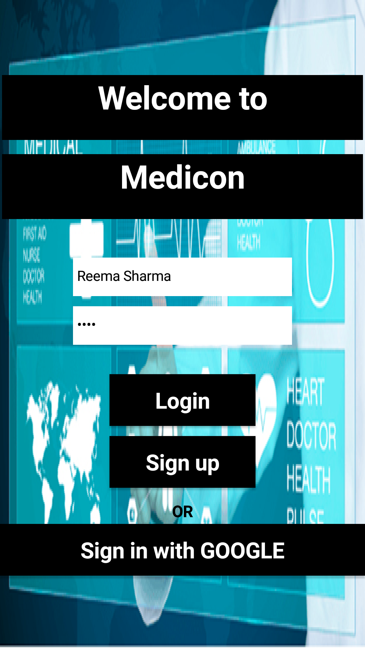
Demo Screenshots
Home page of medicon app.
You can enter username and password to login.
If you are new to the app, you can sign up with google or sign up at the app

Slide 8
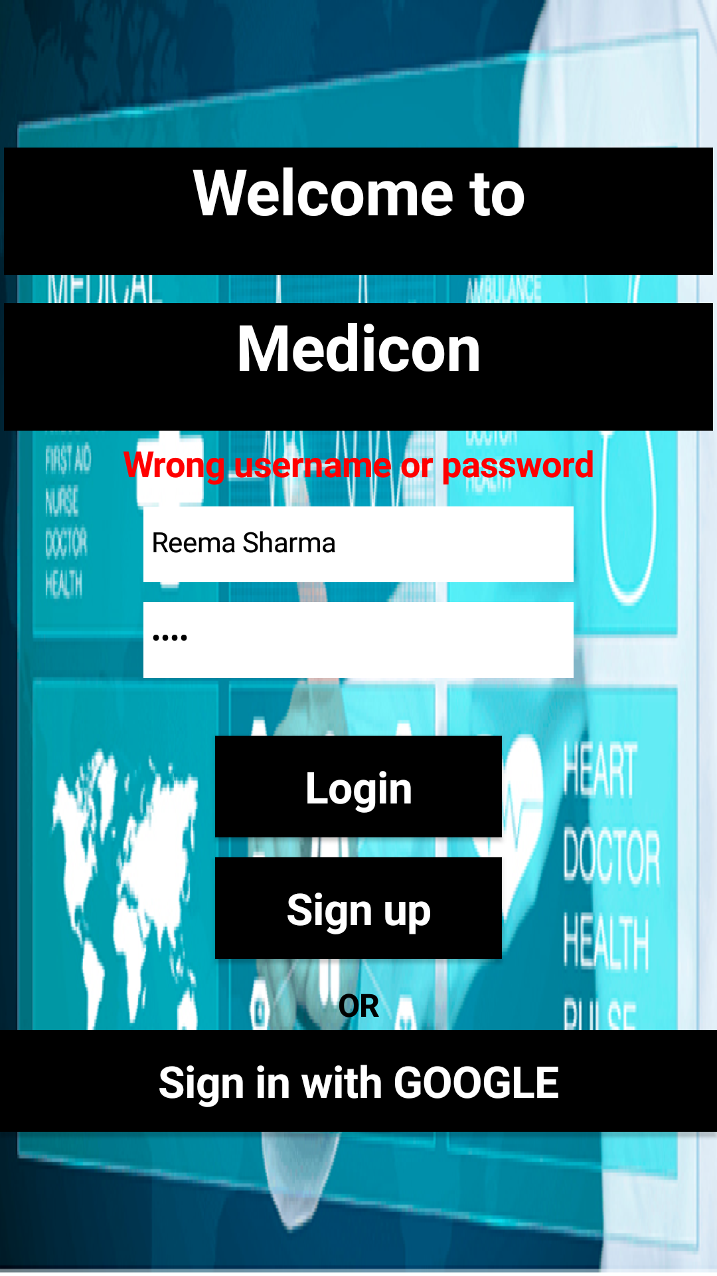
Demo Screenshots
If you enter wrong username or password while logging in

Slide 9
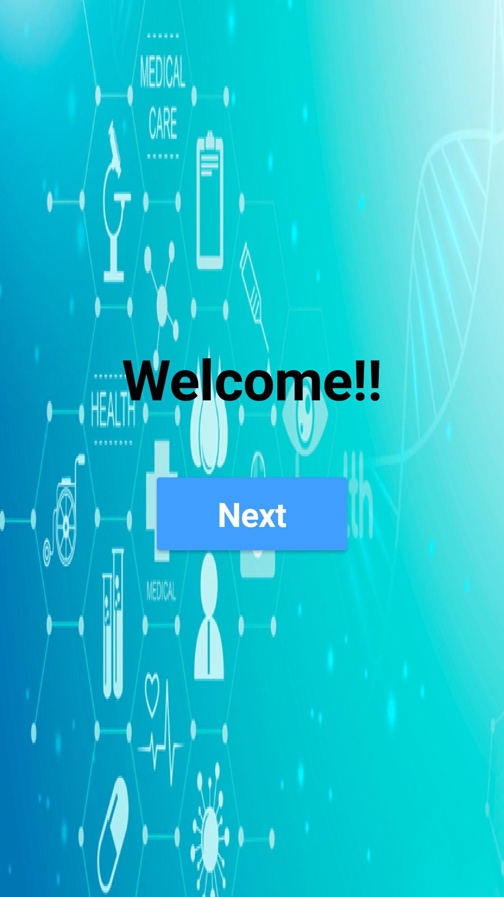
Demo Screenshots
Once you have successfully logged in

Slide 10
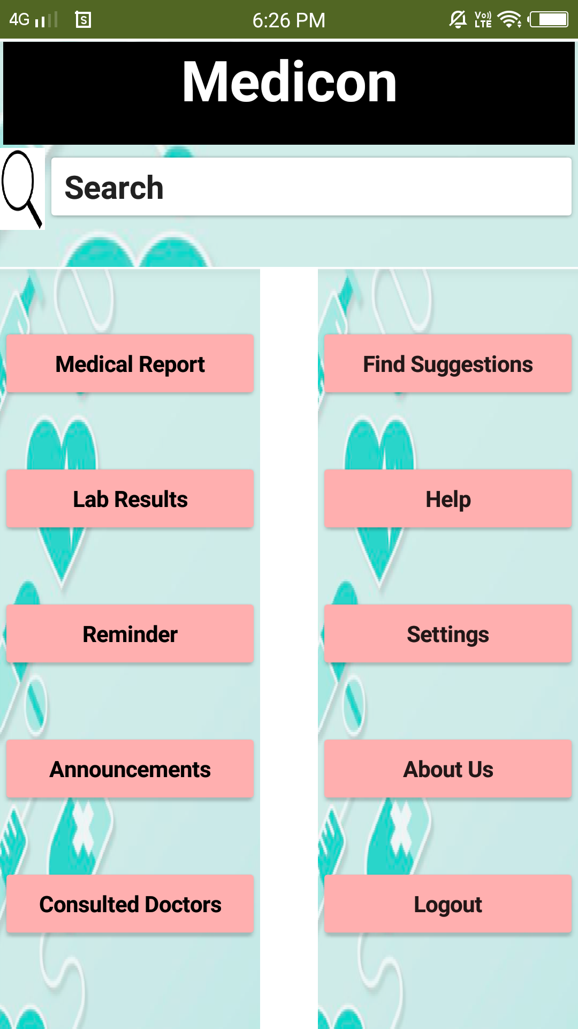
Demo Screenshots
This page comes after welcome
You can search for hospitals, doctors, clinics
Medical reports, lab results, appointment reminders can be accessed.
You see the list of consulted

Slide 11
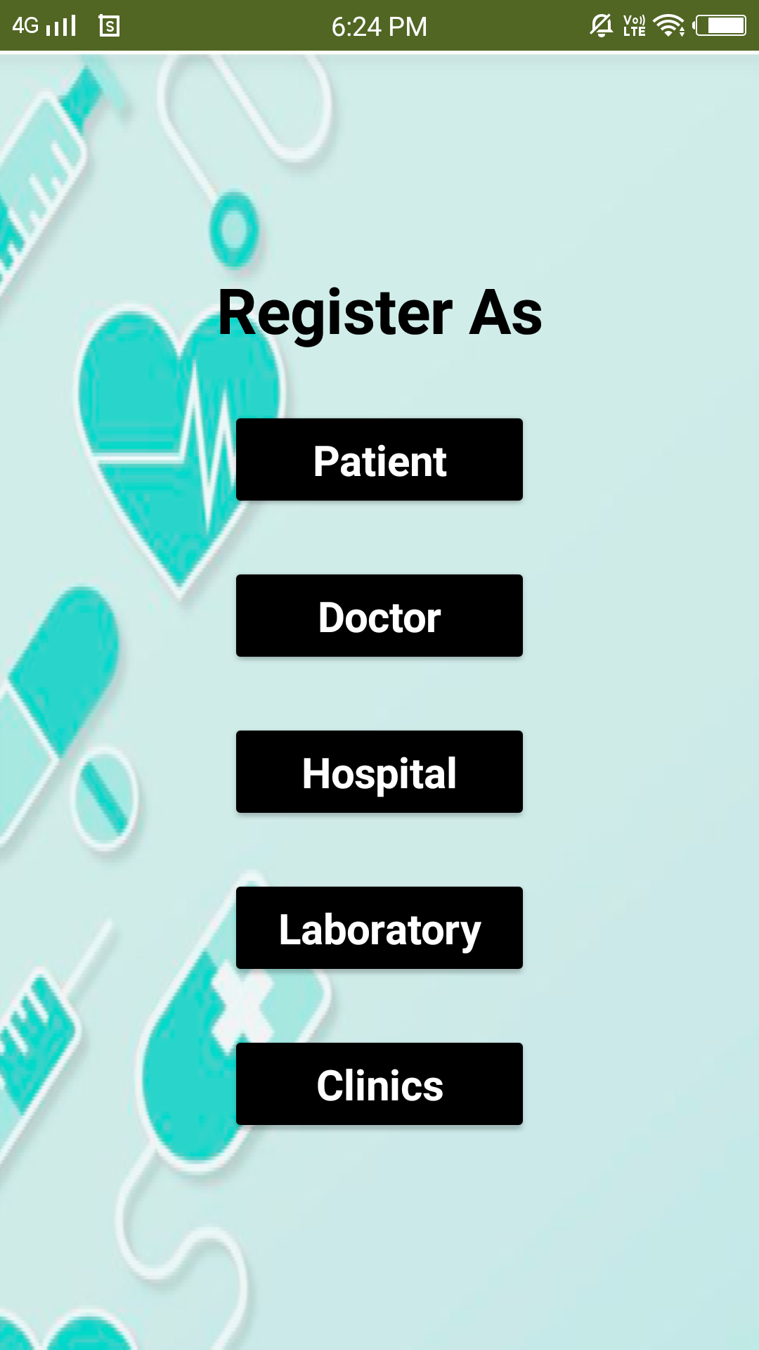
Demo Screenshots
This comes when you click sign up
You can choose your desired option

Slide 12
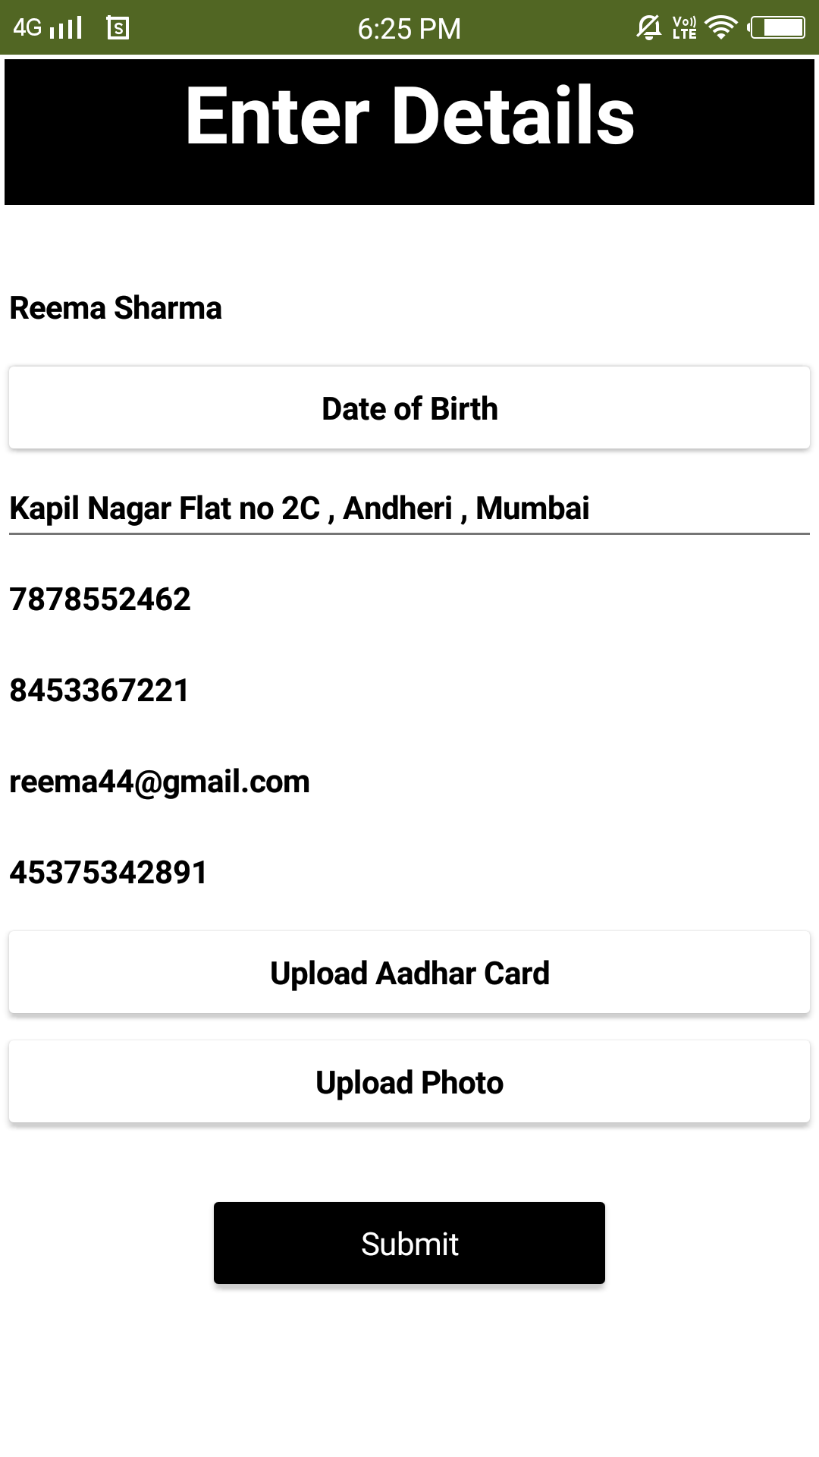
Demo Screenshots
When you sign up as patient you come to this page
Here we can enter details such as name, DOB, address and other required informations.

Slide 13
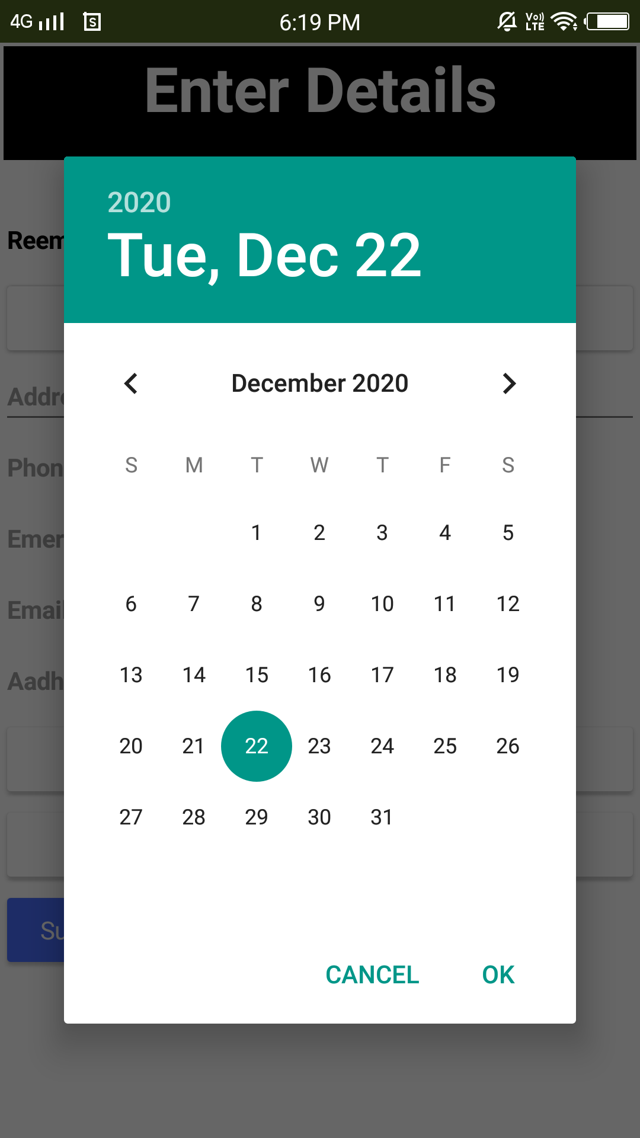
Demo Screenshots
You can choose the DOB from the calendar
Once you submit you can go to the search page shown in slide no: 10

Slide 14

Future scope
Home Delivery of medicines
Availability of doctors
Immediate treatment at emergency situations.
Buy medicines online prescribed by doctor at affordable prices and it will be delivered to homes.
Multilingual Facility
users should be able to operate the app in their desired language.
Resources for security improvements
Instead of one resource, multiple resources should exist or improving application-level security

Slide 15
Conclusion
Appointments are easily done
Improves effectiveness of patient treatment
Allow storage of test results and prescriptions
Attach files to patient history

Slide 16
THANK YOU

